Slide 1
Managing people
Managing people working as individuals and in groups
People are an organisation’s most important assets
1

Slide 2
Management activities
Problem solving (using available people)
Motivating (people who work on a project)
Planning (what people are going to do)
Estimating (how fast people will work)
Controlling (people's activities)
Organizing (the way in which people work)

Slide 3
Problem solving
Requires the integration of different types of knowledge (computer, task, domain, organisation)
Development of a model of the solution and testing of this model against the problem
Representation of this model in an appropriate notation or programming language

Slide 4
Motivation
An important role of a manager is to motivate the people working on a project
Motivation is a complex issue but it appears that their are different types of motivation based on
  Basic needs (e.g. food, sleep, etc.)
  Personal needs (e.g. respect, self-esteem)
  Social needs (e.g. to be accepted as part of a group)

Slide 5
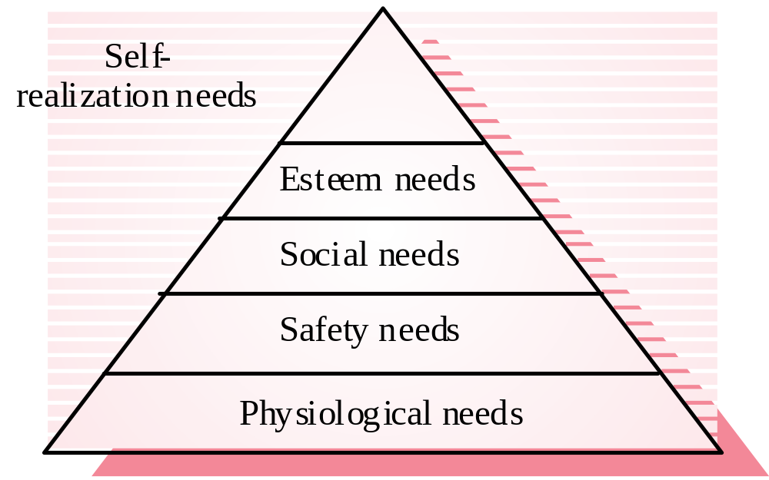
Human needs hierarchy

Slide 6
Personality types
The needs hierarchy is almost certainly an over-simplification
Motivation should also take into account different personality types:
  Task-oriented
  Self-oriented
  Interaction-oriented

Slide 7
Personality types
Task-oriented.
  The motivation for doing the work is the work itself
Self-oriented.
  The work is a means to an end which is the achievement of individual goals - e.g. to get rich, to play tennis, to travel etc.
Interaction-oriented
  The principal motivation is the presence and actions of co-workers. People go to work because they like to go to work

Slide 8
Group working
Most software engineering is a group activity
  The development schedule for most non-trivial software projects is such that they cannot be completed by one person working alone
Group interaction is a key determinant of group
performance
Flexibility in group composition is limited
  Managers must do the best they can with available people

Slide 9
Group composition
Group composed of members who share the
same motivation can be problematic
  Task-oriented - everyone wants to do their own thing
  Self-oriented - everyone wants to be the boss
  Interaction-oriented - too much chatting, not enough work
An effective group has a balance of all types
Can be difficult to achieve because most
engineers are task-oriented
Need for all members to be involved in decisions which affect the group

Slide 10
Group leadership
Leadership depends on respect not title or status
There should be both a technical and a
managerial leader
A career path based on technical competence
should be supported

Slide 11
Group cohesiveness
In a cohesive group, members consider the group to be more important than any individual in it
Advantages of a cohesive group are:
  Group quality standards can be developed
  Group members work closely together so inhibitions caused by ignorance are reduced
  Team members learn from each other and get to know each other’s work
  Egoless programming where members strive to improve each other’s programs can be practised

Slide 12
Group communications
Good communications are essential for effective group working
Information must be exchanged on the status of work, design decisions and changes to previous decisions
Good communications also strengthens group cohesion as it promotes understanding

Slide 13
Group communications
Status of group members
  Higher status members tend to dominate conversations
Personalities in groups
  Too many people of the same personality type can be a problem
Sexual composition of group
  Mixed-sex groups tend to communicate better
Communication channels
  Communications channelled though a central coordinator tend to be ineffective

Slide 14
Group organisation
Software engineering group sizes should be relatively small (< 8 members)
Break big projects down into multiple smaller projects
Small teams may be organized in an informal, democratic way
Chief programmer teams try to make the most effective use of skills and experience

Slide 15
Choosing and keeping people
Choosing people to work on a project is a major managerial responsibility
Appointment decisions are usually based on
  information provided by the candidate (their resume)
  information gained at an interview
  recommendations from other people who know the candidate
Some companies use psychological or aptitude tests
  There is no agreement on whether or not these tests are actually useful

Slide 16
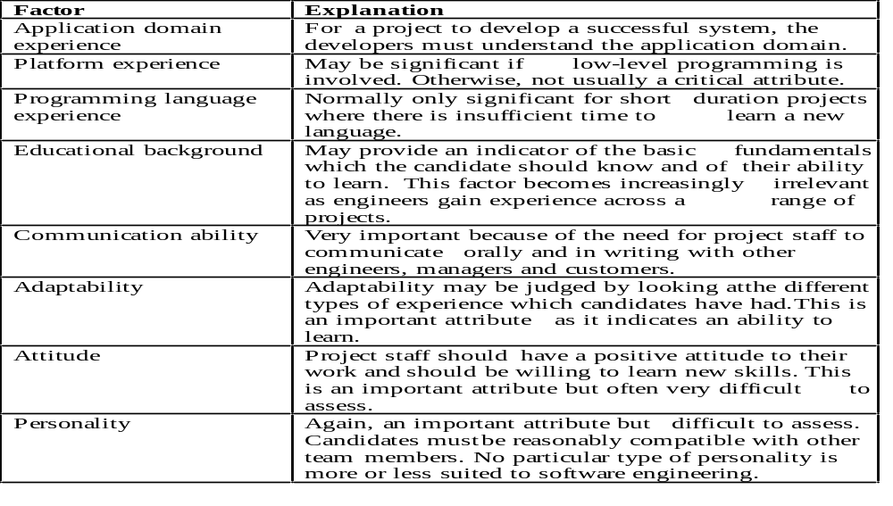
Staff Selection factors

Slide 17
Working environments
Physical workplace provision has an important
effect on individual productivity and satisfaction
  Comfort
  Privacy
  Facilities
Health and safety considerations must be taken into account
  Lighting
  Heating
  Furniture

Slide 18
The People Capability Maturity Model
Five stage model
  Initial. Ad-hoc people management
  Repeatable. Policies developed for capability improvement
  Defined. Standardized people management across the organization
  Managed. Quantitative goals for people management in place
  Optimising. Continuous focus on improving individual competence and workforce motivation

